Slide 1
Creating web APIs with plumber
Alvaro Guijarro May Finn Krueger

Slide 2

Outline
Recap on API’s
Introduction to Plumber
Annotations in Plumber
Plumber Script
More on Annotations
Endpoint Method
Plumber Filter
Parser & Serializer
Further Readings

Slide 3

Introduction to API’s
Bon APItite
Application Programming Interface (API) is an interactive medium through which users can requests specified data from a server
Think of a waiter:
A waiter takes orders from customers and brings those orders to the kitchen. After preparation, the waiter then brings the customers their food.
Equally, clients (customers) make requests (orders) to the server (kitchen) in the form of a protocol (by speaking) and get delivered responses (the food) by the API (waiter)

Slide 4

Introduction to API’s
Additional Concepts
Endpoint: specified URLS that query the requests to the API database
Protocol: the language that computers use to communicate is HTTP
Action verbs determine the type of responses to requests (GET, POST)
More on that later that later
Responses are normally delivered in JavaScript Object Notation JSON (see also the workshop on JSON)
Users
Server
Requests
Endpoints
Protocol
Responses
Credits: Experian

Slide 5
Introduction to API’s
What’s the fuzz about APIs?
APIs deliver access to (large amounts of) structured data saving users the time to do manual web scraping
APIs regulate the data that can be retrieved from a server
Data as well as code (e.g. in the form of functions) can be easily stored and accessed from everywhere
APIs are another way companies can serve their tools and services.
Examples:
YouTube to MP3 converter
Log-In Using Google / Facebook
Pay with PayPal
Do you speak any HTTPS ?

Slide 6
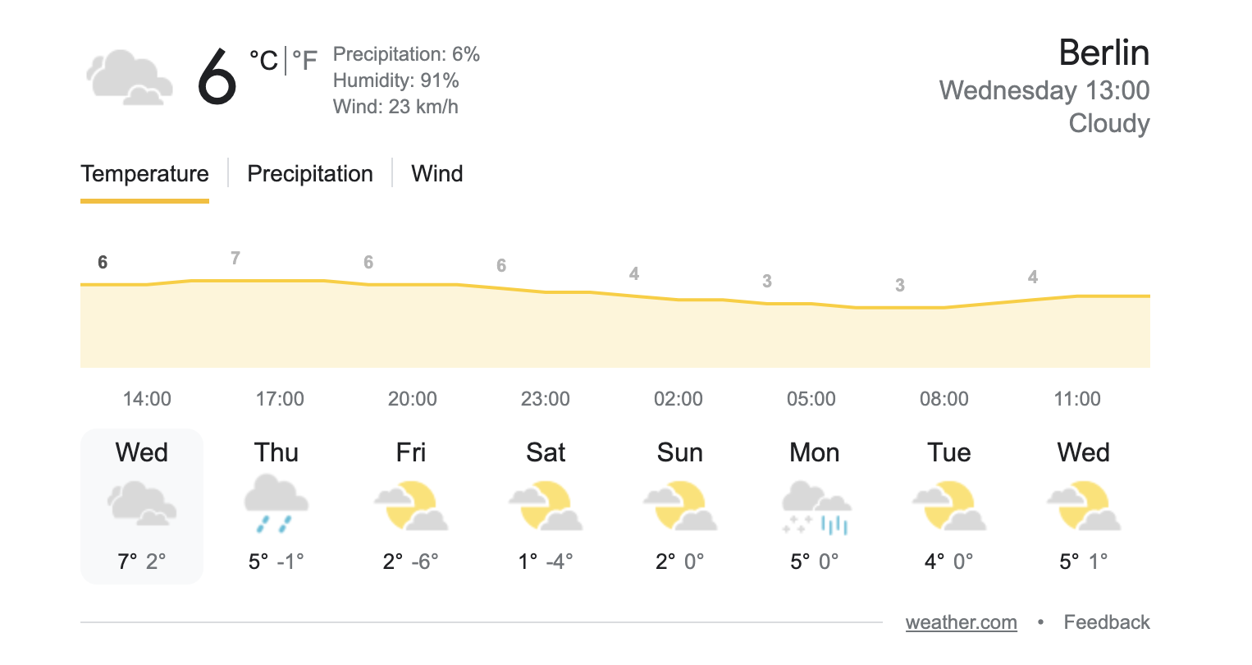

Introduction to API’s
Case Google the weatherforecast for Berlin and
look at what Google responses.
What did I do ?
CREDITS: GOOGLE

Slide 7

Introduction to Plumber
Plumber is an easy to use package for R that allows you to create a web API through which you can share your R code
How does it work
Write the code that you would like to share beyond collaborators and yourself collaborators
Annotate the code that you would like to share with ‘roxygen2‘ type comments using ‘#*‘
Run the API to share the code
potentially: deploy the API to a web server

Slide 8
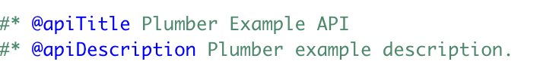





Annotations in Plumber
In response to an HTTP request to the Plumber Endpoints the selected R code is executed.
Incoming requests pass through a set of mechanisms before a response is returned to the client.
The set of mechanisms as well as the main characteristics are determined through plumber annotations such as:
Annotations
Parameters: define the input that is send to the API, enable users to send data
Filter: filter incoming requests before passing the requests to the endpoint
Parser: determine the format in which the request is read (csv/text)
Endpoint Method: determines the Method of response to the requests
Serializer: determine the format in which the response is given
Incoming request
Method of response
Outgoing response

Slide 9
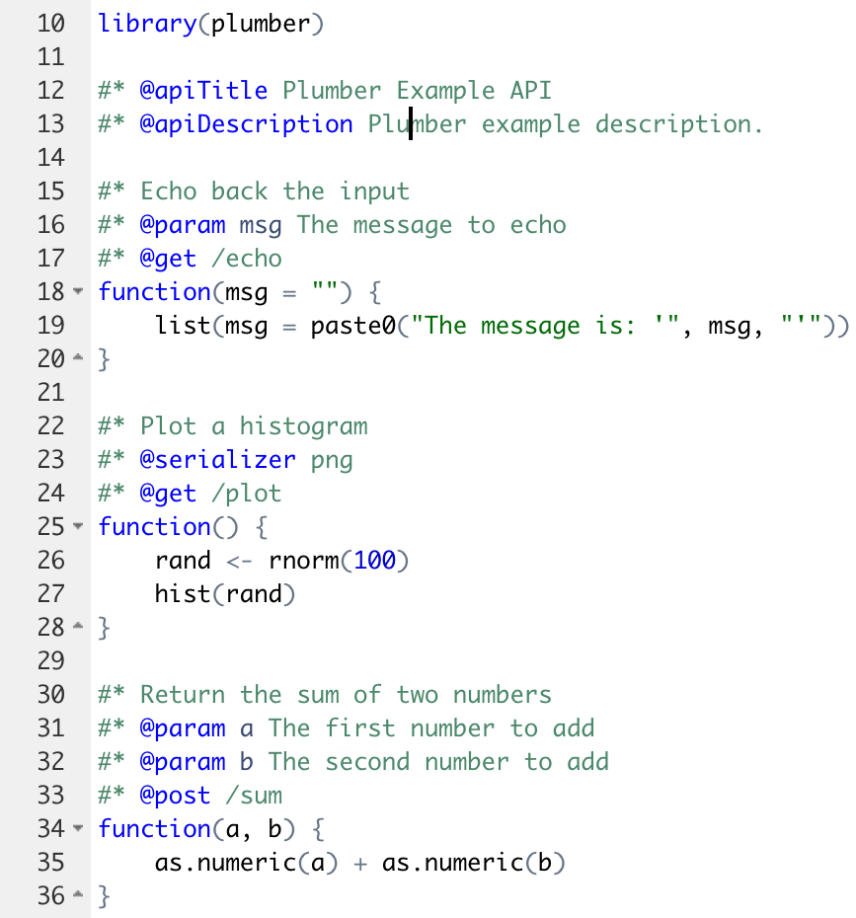
Plumber Script
Global Annotaions:
@param: define a message input
@get: request a source
@serializer: provide output in png format
@get: request a source
@param: define a number input
@param: define a number input
@post: send data in body

Slide 10
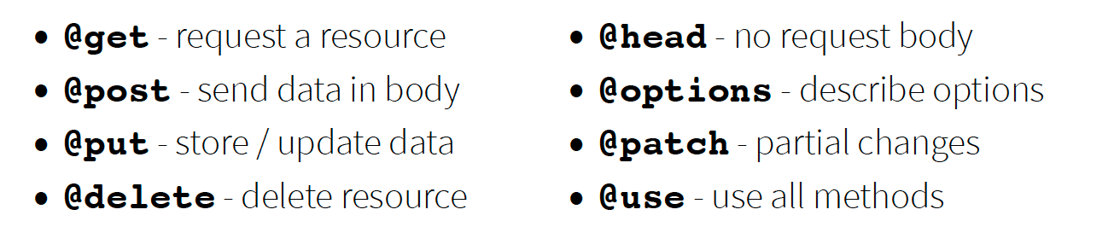

Endpoint Method
Endpoints define the R code that is executed in response to incoming requests.
These endpoints correspond to HTTP methods and respond to incoming by matching the defined method.
Endpoint Methods:
Credit: Plumber Cheat Sheet

Slide 11
Plumber Filter
a Plumber router will pass a request through all the defined filters before it attempts to find an endpoint
Often, filter pass on the request to the next handler after mutating the incoming request
Plumber filters can be used to define a “pipeline” for handling incoming requests.
a filter also could be used to check that a user has authenticated
filter to check Authentication
#* @filter checkAuth
function(req, res){
if (is.null(req$username)){
res$status <- 401 # Unauthorized
return(list(error="Authentication required"))
} else {
plumber::forward()
}
}

Slide 12

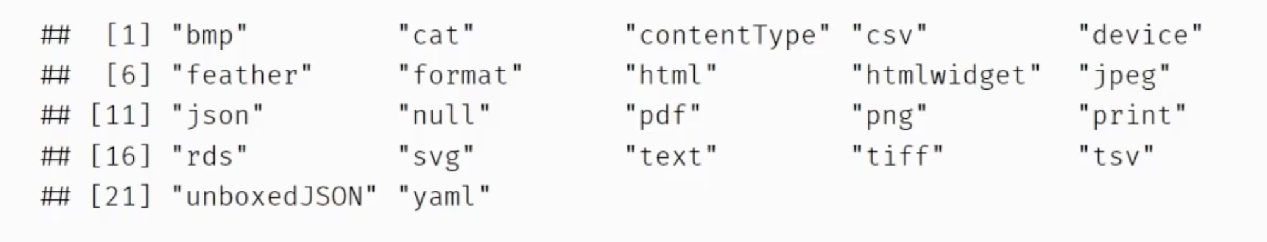
Parser & Serializer
Parser: determine the format in which the request is read
Serializer: determine the format in which the response is given

Slide 13
Further Readings
Basics of Plumber and walk through the creation of a web API from scratch
Integrating R with Plumber APIs on YouTube
APIs examples built in R
Plumber Cheat Sheet

